Slide 1
IE 6700: Data Management for Analytics Case Study Project Presentation Project Title: Agricultural Management System
Teamates :
Hari Chandana Kannuru
Likitha Kukunarapu

Slide 2
Background information and Business problem
Agriculture serves as the foundation of human survival, furnishing sustenance providing essential resources, and livelihoods for a significant portion of the global population. The agricultural supply chain is a complex ecosystem involving multiple stakeholders, primarily customers, farmers, and suppliers. It includes managing crop inventory, coordinating the supply chain, fostering customer interactions, ensuring secure transactions, and leveraging data for continuous improvement which are difficult challenges. The Agricultural Management System (AMS) is designed to assist in these the agricultural operations.
Our Management system addresses these challenges, by providing necessary database structure in this user-friendly interface for farmers to navigate these complexities. The Agricultural Management System doesn't just store data, it helps farmers make smart decisions by keeping track of which crops are doing well, how much is available, and offers insights into customer preferences, and overall business trends. It plays a crucial role in making farming more productive and organized.

Slide 3
Business requirements
The database in this online web application stores the data of the users i.e., farmers and customers. The data such as ID, name, username, password, contact number, mail id are stored. The person logs in as either farmer or customer has unique ID generated for them. When a farmer logins additional requirement Farm Location is added in the database. For a customer login the shipping address is stored. Farmer sells the product crops to customers. It stores product information and has a shopping cart, where the products chosen from the catalog are stored before they are ready to place their order. The Product crop has ID, name, price, description and available quantity. After the order confirmation, payment and shipping details are recorded. The customer places order, the order contains the order date recorded. At the same time, when a payment is made the payment type, payemnt ID, payment amount are recorded in the database. The shipment shows the destination and estimated delivery information.
OTHER REQUIREMENT:
A farmer can provide multiple product crops but at least one product crop.
The customer can place zero to many orders whereas the particular order is placed by a single customer.
The customer has a shopping cart which can have multiple crops.
The supplier provide multiple but at least one tool to farmers and farmers can purchase multiple tools from the suppliers.
Customer can also give zero to multiple feedbacks to the crops he purchased and similarly the crop can have zero to multiple feedbacks.

Slide 4
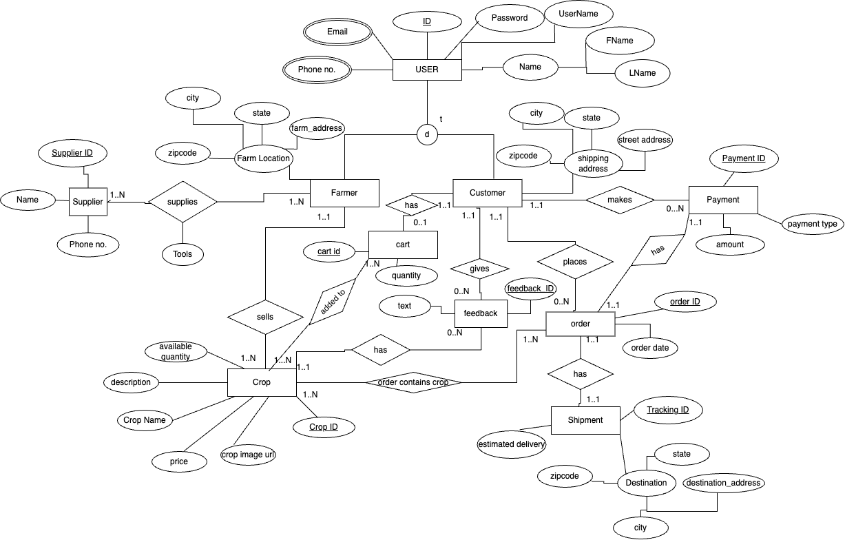
Conceptual data model (EER and/or UML)

Slide 5
Relational model
Primary keys - BOLD and UNDERLINED, Foreign keys – Italic
Table 1 · USER (User ID, username, password, F Name, L Name)
Userid primary key
Table 2 · USER-EMAIL (Email, User ID)
Email is primary key
The FOREIGN KEY User ID refers to User ID in User; NULL NOT ALLOWED
Table 3 · USER-PHONE NO (Phone no, User ID)
Phone no primary key
The FOREIGN KEY User ID refers to User ID in User; NULL NOT ALLOWED
Email and phone number are multivalued attributes.
Table 4 · FARMER (F.User ID, Farm address, city, state, zipcode)
The FOREIGN KEY User ID refers to user table user id; NULL NOT ALLOWED also serves as primary key
Table 5 · CUSTOMER (C.User ID, streetAddress, city,state, zipcode)
The FOREIGN KEY c.User ID refers to User ID in Customer; NULL NOT ALLOWED also serves as primary key
Table 6 · SUPPLIER (Supplier ID, Name, Phone no)

Slide 6
Table 7 · SUPPLIES (Supplier ID, F.User ID, Tools)
The FOREIGN KEY Supplier ID refers to Supplier ID in Supplier; NULL NOT ALLOWED
The FOREIGN KEY F.User ID refers to User ID in Farmer; NULL NOT ALLOWED
Table 8 · CROP (Crop ID, F.User ID, Crop image URL, Price, Crop name, Description, Available quantity)
The FOREIGN KEY F.User ID refers to User ID in Farmer; NULL NOT ALLOWED
Table 9· CART (Cart ID, Quantity, C.UserID)
Table 10 CROPADDED TO CART (Cart ID, CropID)
Table 10· PAYMENT (Payment ID, C.User ID,OrderID, Payment Date, Payment Type, Amount).
The FOREIGN KEY C.User ID refers to User ID in Customer; NULL NOT ALLOWED
The FOREIGN KEY OrderID refers to User ID in Customer; NULL NOT ALLOWED
Table 11· ORDER (Order ID, C.User ID, Order date)
The FOREIGN KEY C.User ID refers to User ID in Customer; NULL NOT ALLOWED
Table 12.· ORDER CONTAINS CROP (Order ID, Crop ID)
The FOREIGN KEY Order ID refers to Order ID in Order; NULL NOT ALLOWED
The FOREIGN KEY Crop ID refers to Crop ID in Crop; NULL NOT ALLOWED
Table 13· SHIPMENT (Tracking ID, Order ID, destination address, city,zip, Estimated Delivery)
The FOREIGN KEY Order ID refers to Order ID in Order; NULL NOT ALLOWED
Table 14· FEEDBACK (Feedback ID, Crop ID, C.User ID, Text)
The FOREIGN KEY Crop ID refers to Crop ID in Crop; NULL NOT ALLOWED
The FOREIGN KEY C.User ID refers to User ID in Customer; NULL NOT ALLOWED
· ALL PRIMARY KEYS MENTIONED ABOVE ARE REGISTERED AS NULL NOT ALLOWED

